Slide 1
Malignant comments project
Submitted by:
Yogesh Mudliar

Slide 2
Problem Statement
The proliferation of social media enables people to express their opinions widely online.However, at the same time, this has resulted in the emergence of conflict and hate, making online environments uninviting for users. Although researchers have found that hate is a problem across multiple platforms, there is a lack of models for online hate detection.
Online hate, described as abusive language, aggression, cyberbully, hatefulness and many others has been identified as a major threat on online social media platforms. Social media platforms are the most prominent grounds for such toxic behavior.
There has been a remarkable increase in the cases of cyberbully and trolls on various social media platforms. Many celebrities and influences are facing backlashes from people and have to come across hateful and offensive comments. This can take a toll on anyone and affect them mentally leading to depression, mental illness, self-hatred and suicidal thoughts.
Our goal is to build a prototype of online hate and abuse comment classifier which can used to classify hate and offensive comments so that it can be controlled and restricted from spreading hatred and cyberbully.

Slide 3
Exploratory data analysis
Defining the problem statement
Collecting the data
Cleaning the data
-Removing major errors, duplicates, and outliers
-Removing unwanted data points
-Bringing structure to your data
-Filling in major gaps
Analyzing the data
Sharing your results

Slide 4
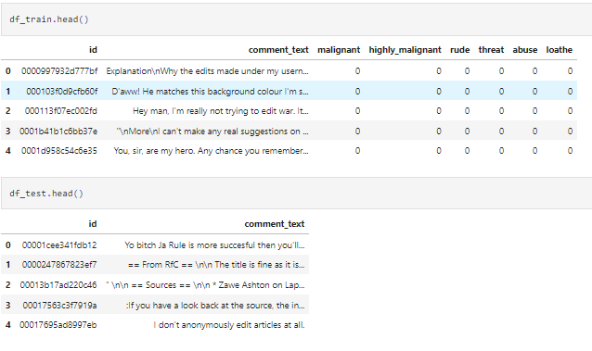
Data Sources and their formats
Our train and test data set:

Slide 5
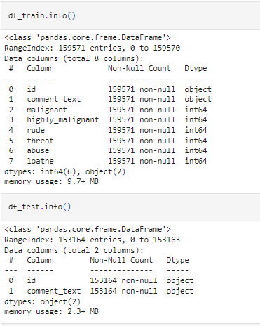
Data Information
Our train and test data set INFO:

Slide 6
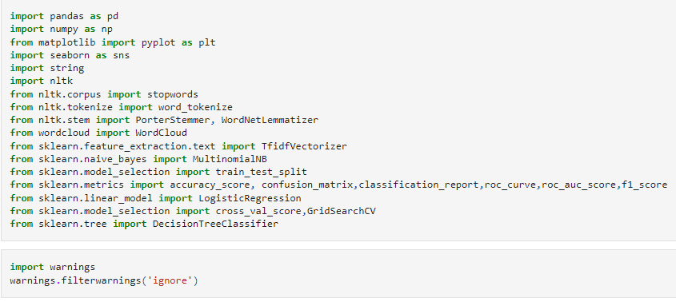
Software used
I used all of this software tools and algorithms:

Slide 7
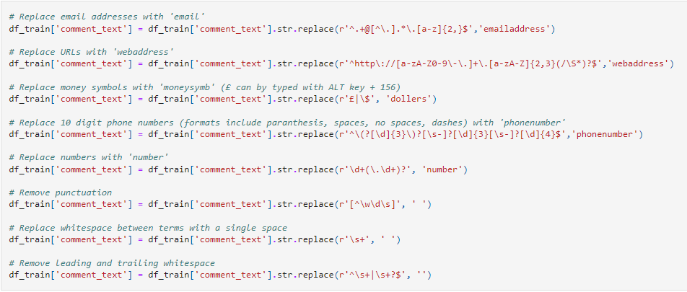
DATA PRE PROCESSING
CLEANING TRAIN DATA SET

Slide 8
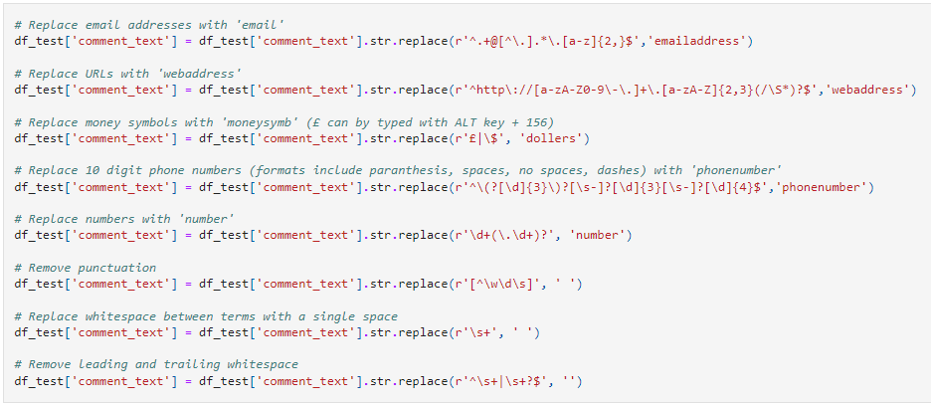
Continue....
CLEANING TEST DATA SET

Slide 9
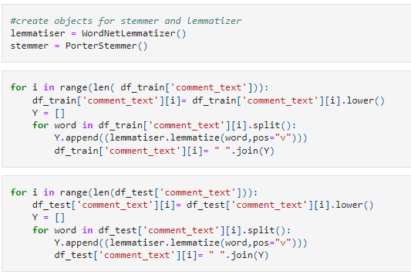
Continue....
STEMMING AND LEMMATIZATION:Stemming is a process that stems or removes last few characters from a word, often leading to incorrect meanings and spelling. Lemmatization considers the context and converts the word to its meaningful base form, which is called Lemma. For instance, stemming the word 'Caring' would return 'Car

Slide 10
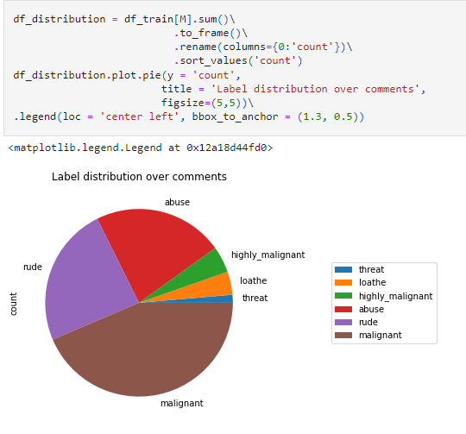
Visualizations
We can observe that malignant there are 50% of malignant comments present in our train data set:

Slide 11
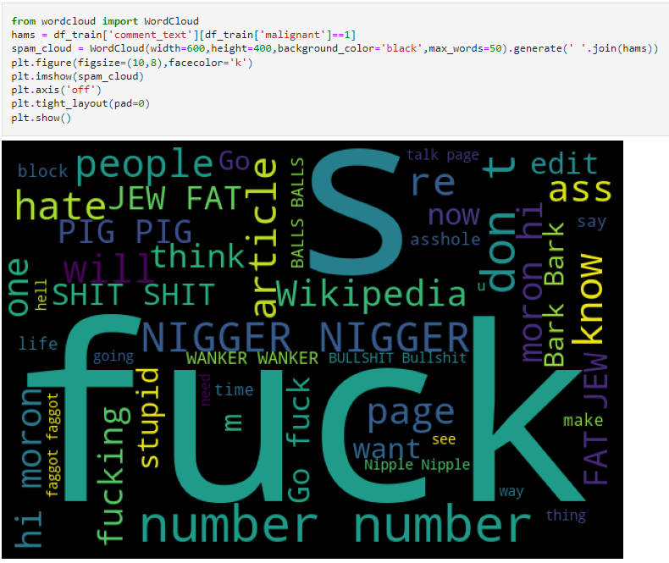
Continue....
Train Word Cloud Significant textual data points can be highlighted using a word cloud.

Slide 12
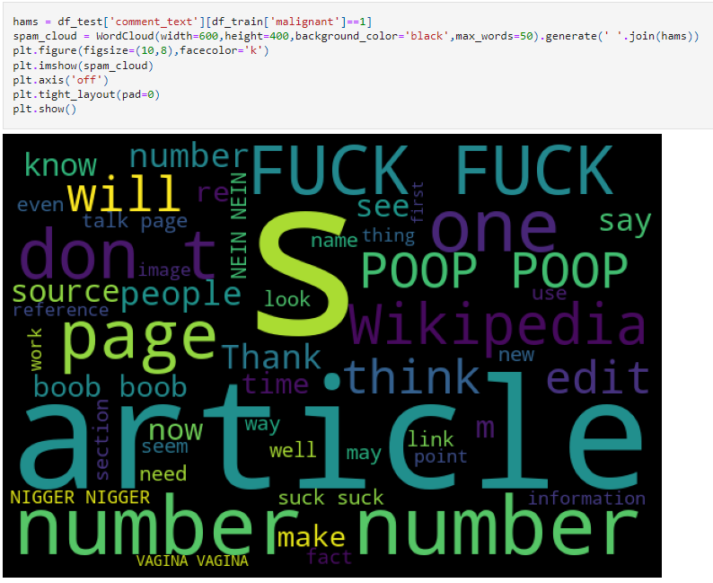
Continue....
TEST Word Cloud Significant textual data points can be highlighted using a word cloud.

Slide 13
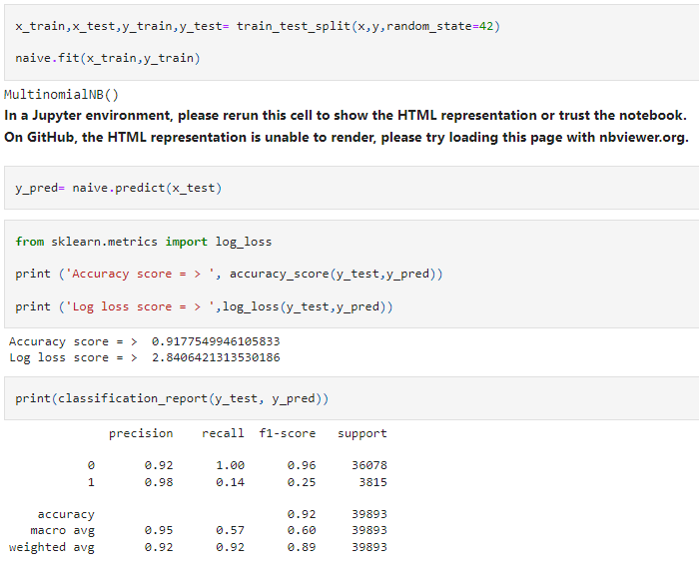
Run and Evaluate selected models
Multinomial Naive Bayes:

Slide 14
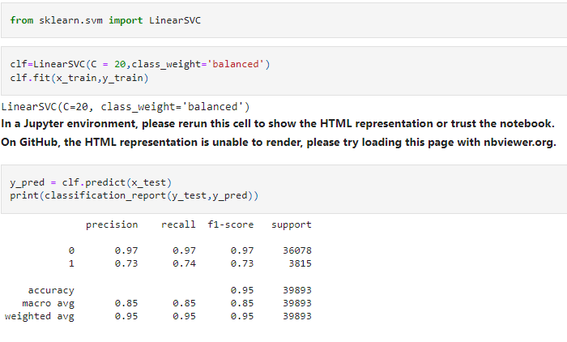
Continue....
Linear SVC

Slide 15
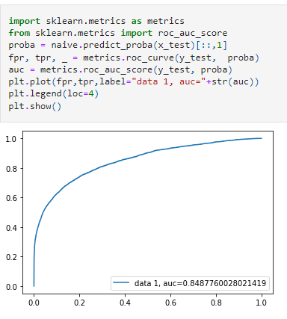
Interpretation of the Results
We plotted AUC-RUC curve and got AUC= 0.84, another common metric is AUC, area under the receiver operating characteristic (ROC) curve. The Receiver operating characteristic curve plots the true positive (TP) rate versus the false positive (FP) rate at different classification thresholds.

Slide 16
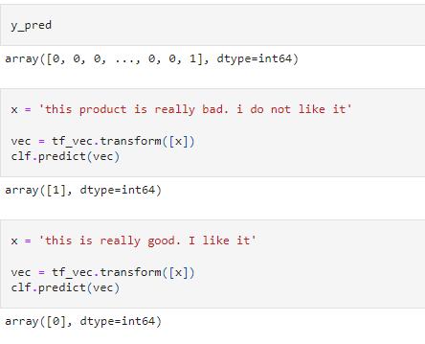
Continue....
We also test our model by some good and bad comments:

Slide 17
CONCLUSION
This paper proposed a Machine Learning Approach combined with Natural Language Processing for toxicity detection and its type identification in user comments.
Finally, the Mean Validation Accuracy, so obtained, is 92% which is by far the highest ever numeric accuracy reached by any Comment Toxicity Detection Model.
The research done in this paper is intended to enhance fair online talk and views sharing in social media.
A more robust model can be developed by applying Grid Search Algorithm on the same dataset over the Machine Learning Algorithms for every pipeline, being used in order to obtain better results and accurate classifications

Slide 18


